Slide 1

Technical Schedule
Giuseppe
Macca
Analytics Algorithms

Slide 2

Technical Schedule
Name: Claudio Jeremías Echeverri
Citizenship: Argentina
born: 02/gen/2006
Position: AMR, AML, AMC, ST
Foot: Right
Height: 170 CM
Club: CA River Plate

Slide 3
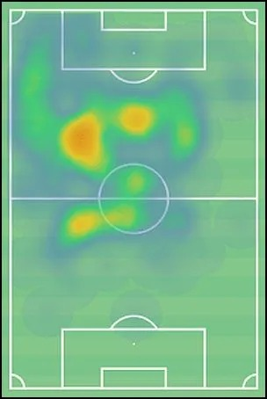
SEASON HEATMAP

Slide 4
PHYSICAL
Acceleration | 68
Agility | 60
Balance | 60
Jumping Reach | 43
Natural Fitness | 66
Pace | 68
Stamina | 35
Strength | 42

Slide 5
MENTAL
Aggression | 54
Anticipation | 66
Bravery | 55
Composure | 48
Concentration | 49
Decisions | 79
Determination | 77
Flair | 90
Leadership | 20
Off the Ball | 72
Positioning | 34
Teamwork | 55
Vision | 74
Work Rate | 60

Slide 6
TECHNICAL
Corners | 43
Crossing | 60
Dribbling | 81
Finishing | 60
First Touch | 90
Free Kick Taking | 70
Heading | 41
Long Shots | 61
Long Throws | 28
Marking | 33
Passing | 72
Penalty Taking | 16
Tackling | 48
Technique | 80

Slide 7
INJURY HISTORY

Slide 8
BEST ROLES (SUITABLE)
Winger (Attack)66.1
Enganche (Support)65.5
Advanced Playmaker (Support)64.3
Advanced Playmaker (Attack)64.2
Attacking Midfielder (Support)64.1

Slide 9
STATUS ABILITY GLOBAL
OVERALL PREVIEW

Slide 10
The parameters indicate that it is similar to
Arda Güler AMR, AMC Real Madrid
Eliesse Ben Seghir MC, AMC AS Monaco
Isaac Babadi AMR, AML, AMC PSV
Valentín Carboni AMR, AMC, ST Monza
Simone Pafundi AMR, AMC Udinese

Slide 11
current player value
potential future value
Giuseppe Macca

